Slide 1
Designing Stage
Individual ICT Project

Slide 2
Example
Project Topic:
INVENTORY MANAGEMENT SYSTEM FOR TELE SOON PHONE SHOP

Slide 3

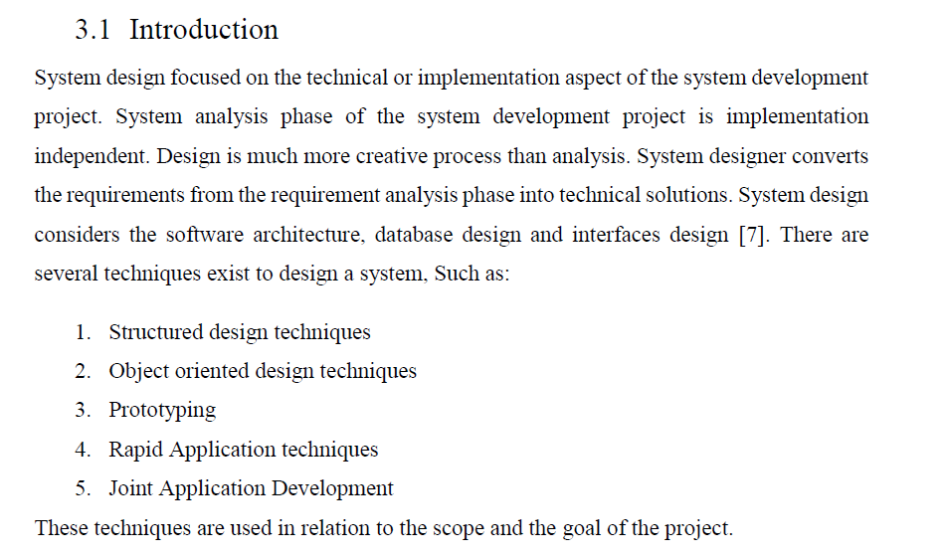


Slide 4
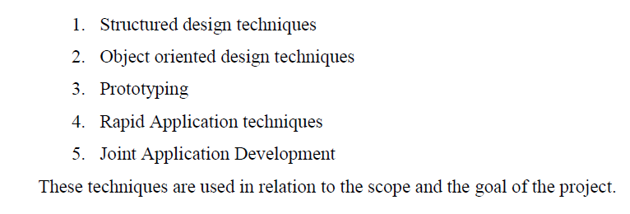
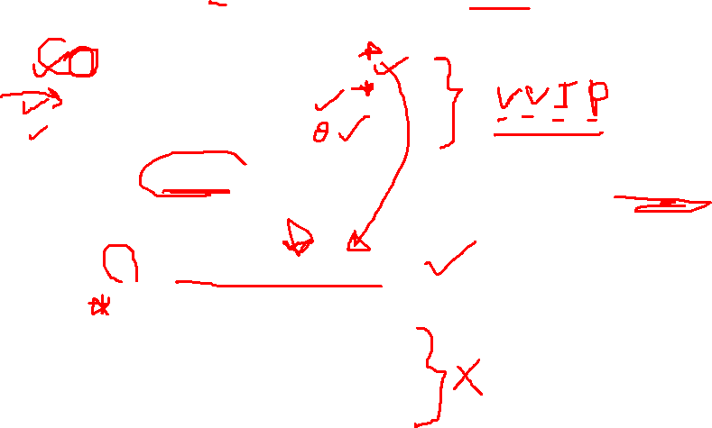
Designing a software project
In the design stage, the designer converts REQUIREMENTS in to the TECHNICAL SOLUSION.
The system design include followings:
  Software architecture
  Database design
  Interfaces design
For the designing stage there are several techniques that can support:

Slide 5
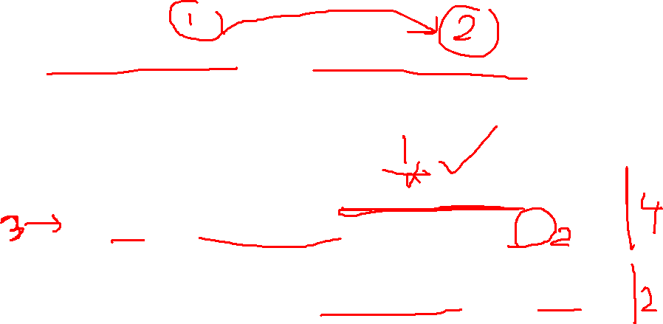
System Analysis/Systems Designing (SA/SD) involves 2 phases:
Analysis Phase: It uses Data Flow Diagram, Data Dictionary, State Transition diagram and ER diagram.
Design Phase: It uses Structure Chart and Pseudo Code.

Slide 6
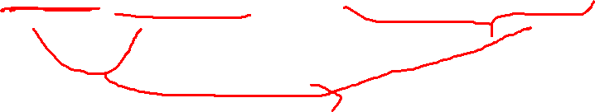
Data Flow Diagrams
A Data Flow Diagram (DFD) is a traditional visual representation of the information flows within a system.
A neat and clear DFD can depict the right amount of the system requirement graphically. It can be manual, automated, or a combination of both.

Slide 7
The following observations about DFDs are essential:
All names should be unique. This makes it easier to refer to elements in the DFD.
Remember that DFD is not a flow chart. Arrows is a flow chart that represents the order of events; arrows in DFD represents flowing data. A DFD does not involve any order of events.
Overcome logical decisions. If we ever have the urge to draw a diamond-shaped box in a DFD, suppress that urge! A diamond-shaped box is used in flow charts to represents decision points with multiple exists paths of which the only one is taken. This implies an ordering of events, which makes no sense in a DFD.
Do not become complicated with details. Postpone error conditions and error handling until the end of the analysis.

Slide 8
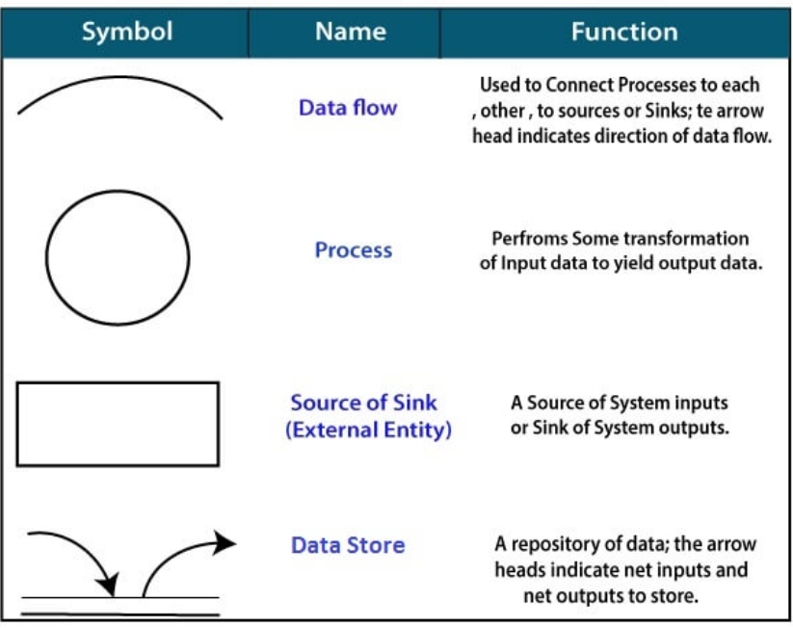
Standard symbols for DFDs are derived from the electric circuit diagram analysis and are shown in fig:

Slide 9
Circle: A circle (bubble) shows a process that transforms data inputs into data outputs.
Data Flow: A curved line shows the flow of data into or out of a process or data store.
Data Store: A set of parallel lines shows a place for the collection of data items. A data store indicates that the data is stored which can be used at a later stage or by the other processes in a different order. The data store can have an element or group of elements.
Source or Sink: Source or Sink is an external entity and acts as a source of system inputs or sink of system outputs.

Slide 10
Levels in Data Flow Diagrams (DFD):
The DFD may be used to perform a system or software at any level of abstraction.
Infact, DFDs may be partitioned into levels that represent increasing information flow and functional detail.
Levels in DFD are numbered 0, 1, 2 or beyond. Here, we will see primarily three levels in the data flow diagram, which are:
  0-level DFD,
  1-level DFD, and
  2-level DFD.

Slide 11
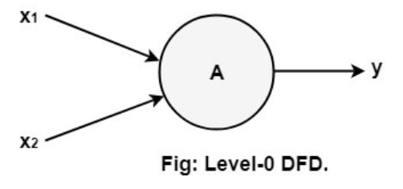
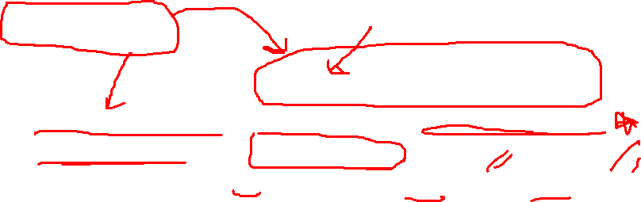
0-level DFD:
It is also known as fundamental system model, or context diagram represents the entire software requirement as a single bubble with input and output data denoted by incoming and outgoing arrows.

Slide 12
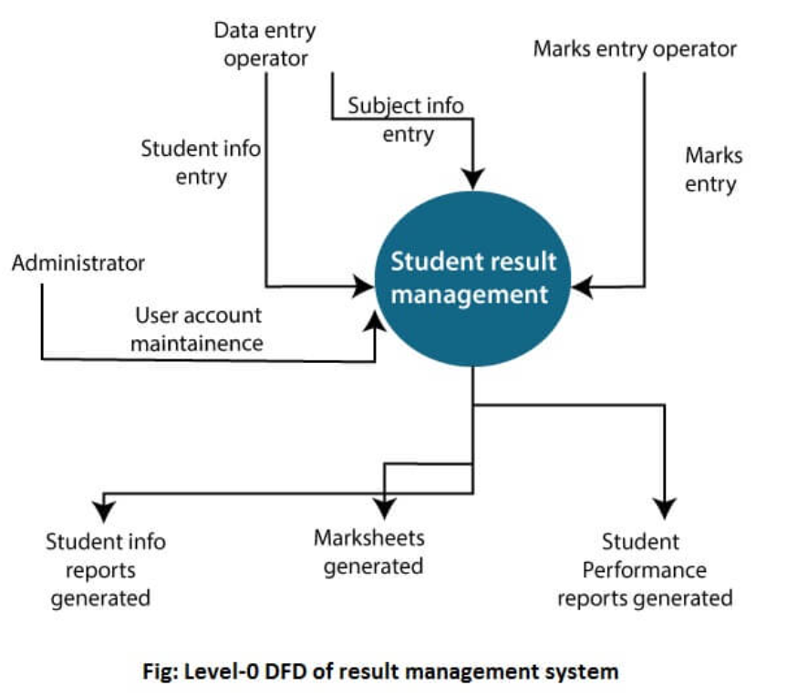
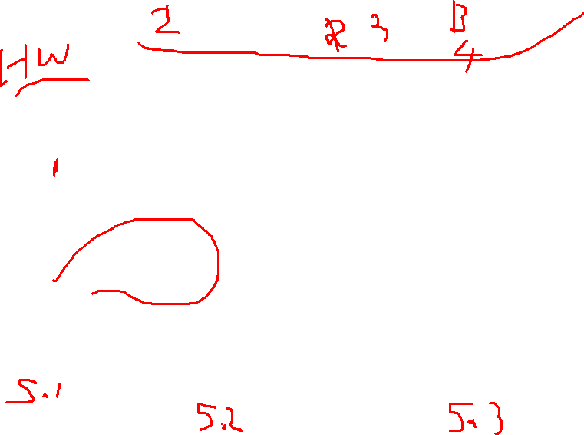
The Level-0 DFD (context diagram) of the result management system is shown in fig.
As the bubbles are decomposed into less and less abstract bubbles, the corresponding data flow may also be needed to be decomposed.

Slide 13
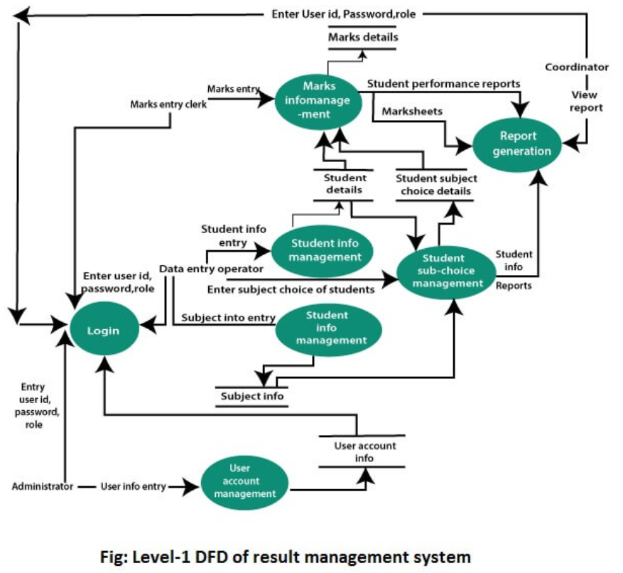
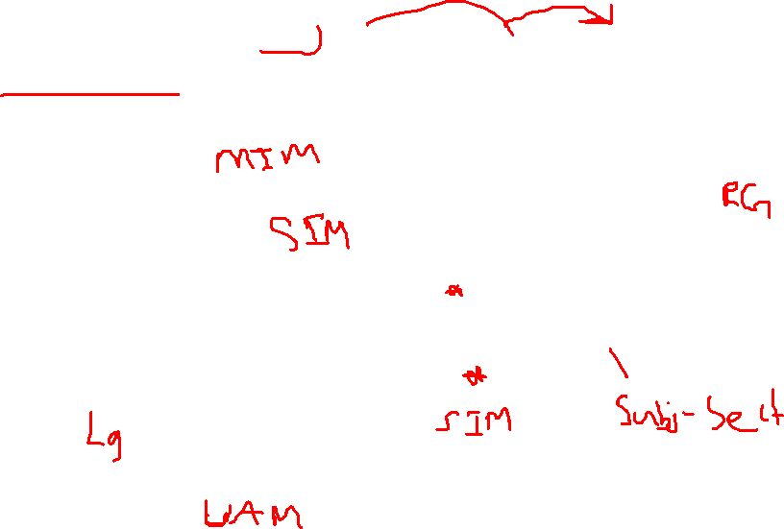
1-level DFD: In 1-level DFD, a context diagram is decomposed into multiple bubbles/processes. In this level, we highlight the main objectives of the system and breakdown the high-level process of 0-level DFD into subprocesses.

Slide 14
2-Level DFD: 2-level DFD goes one process deeper into parts of 1-level DFD. It can be used to project or record the specific/necessary detail about the system's functioning as follows.
User account maintenance
Login
Student Information Management
Subject Information Management
Student Subject Choice Management
Marks Information Management

Slide 15
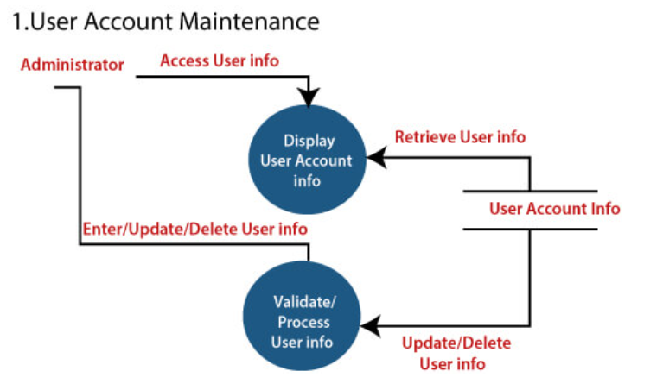
1. User account maintenance:

Slide 16
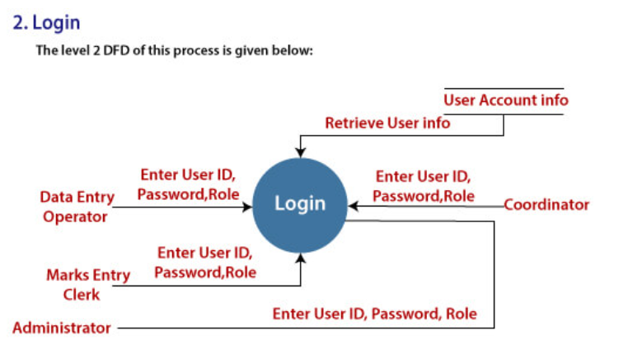
2. Login:

Slide 17
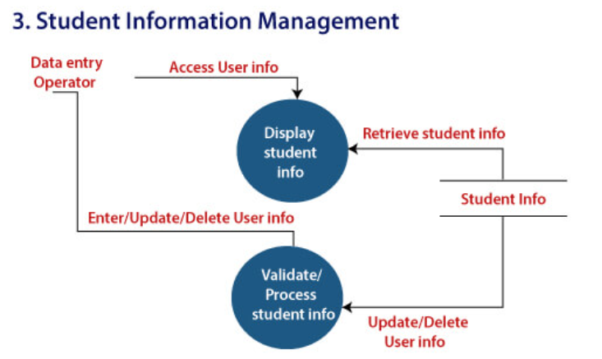
3. Student Information Management:

Slide 18
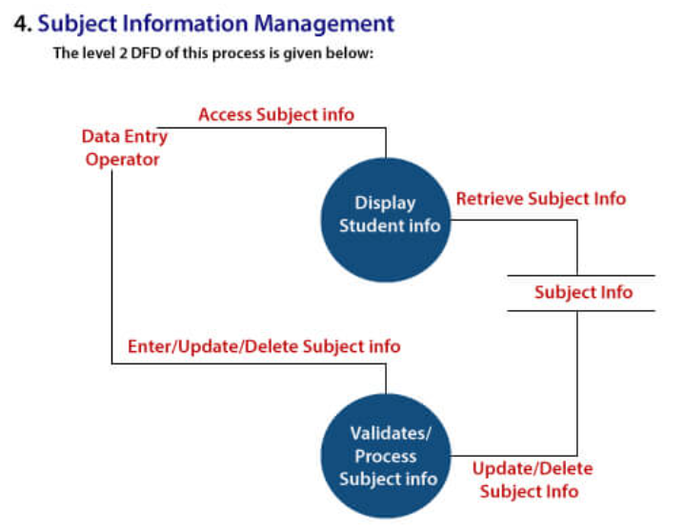
4. Subject Information Management:

Slide 19
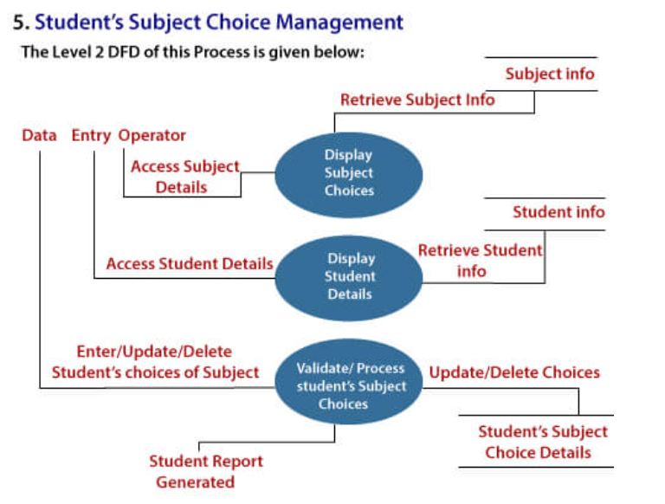
5. Student Subject Choice Management:

Slide 20
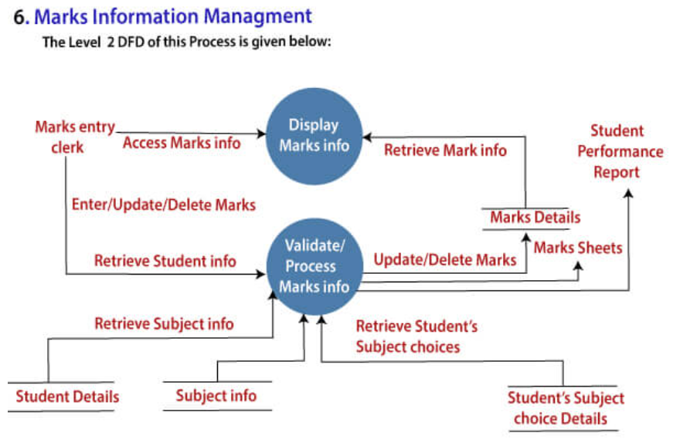
6. Marks Information Management:

Slide 22
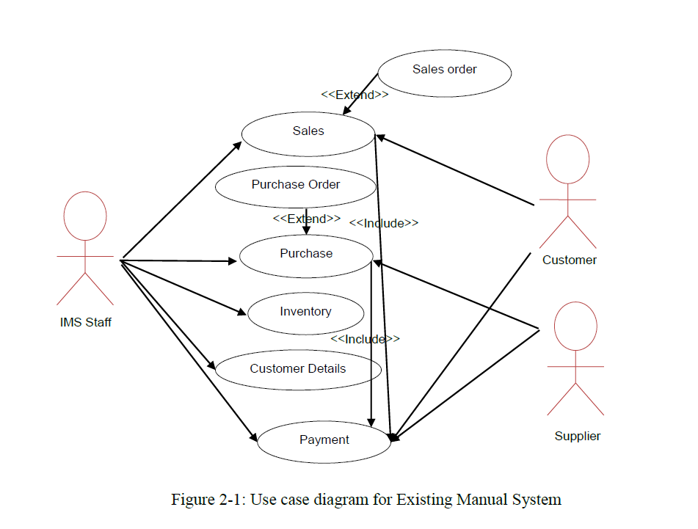

Slide 23
References
https://www.javatpoint.com/software-engineering-data-flow-diagrams

